Slide 1
Hungry Hub
From Click to Cuisine: Because Hunger Waits for No One!

Slide 2
Our Team
Ashi Tyagi
Ankit Lall
Shivani Datar
Esha Patel
NUID: 002706544
NUID: 002799095
NUID: 002772160
NUID: 002244795

Slide 3
About Hungry Hub
Hungry Hub is a cutting-edge food delivery website designed for a seamless experience on both desktop and mobile devices
Utilizing the MERN stack, it ensures robust security, responsive design, and efficient end-to-end transactions
From browsing menus to placing orders, Hungry Hub ensures a smooth end-to-end transactional process
Hungry Hub ensures user data security through advanced encryption and bcrypt-secure login pages, creating a safe and trustworthy environment for our users
Hungry Hub's design effortlessly adapts to all screens, blending ReactJS, CSS, and Bootstrap for an appealing, intuitive interface
Hungry Hub features two key roles – Admins and Users. Admins wield powerful tools for effective platform management, while Users enjoy a personalized and convenient ordering experience.
Users can create and manage their profiles, providing preferences, delivery addresses, and order history.

Slide 4
Tech Stack
MongoDB
ReactJS
ExpressJS
NodeJS
stores and manages data for our food delivery platform.
the frontend library, enables the creation of interactive and responsive user interfaces
Handles routing, middleware, and simplifies server-side logic for enhanced efficiency.
executes server-side code, providing a fast and scalable runtime environment

Slide 5
Features
01
02
03
04
Intuitive User Interface,
Mobile-Friendly Experience,
Responsive Design
Personalized User Profiles,
Admin Tools for Management
secure and convenient payment experience,
Session Management,
password encryption for user accounts
Git for Version Control
MERN architecture

Slide 6
Roles
Admin
User
Enjoy secure and seamless payment transactions
Access detailed order history and analytics
Mobile-friendly interface for convenient ordering on-the-go
Efficient login and secure session management for users
Manage menus with efficiency
Oversee and optimize platform operations
Implement updates promptly
Streamline user management for smooth operation
Utilize search option for efficient menu navigation
Ensure secure and seamless payment gateway integration
Monitor and respond to customer reviews for continuous improvement
Accessible on both desktop and mobile devices, ensuring a mobile-friendly experience
Efficient login and secure session management for administrators

Slide 7
CRUD operation
Create
Update
Read
Delete
C
U
Introduce new menu items with details
Create and customize user profiles
Modify menu items, prices, or descriptions
Edit and update user profiles and preferences
Modify saved delivery addresses
R
D
Browse and search through the menu efficiently
Read menu item descriptions
View and analyze order history and analytics
Monitor customer reviews and ratings
Access detailed order history
Read user profiles and preferences
Remove outdated or unavailable menu items
Delete or deactivate user accounts
Remove saved delivery addresses
Clear order history or saved items

Slide 8

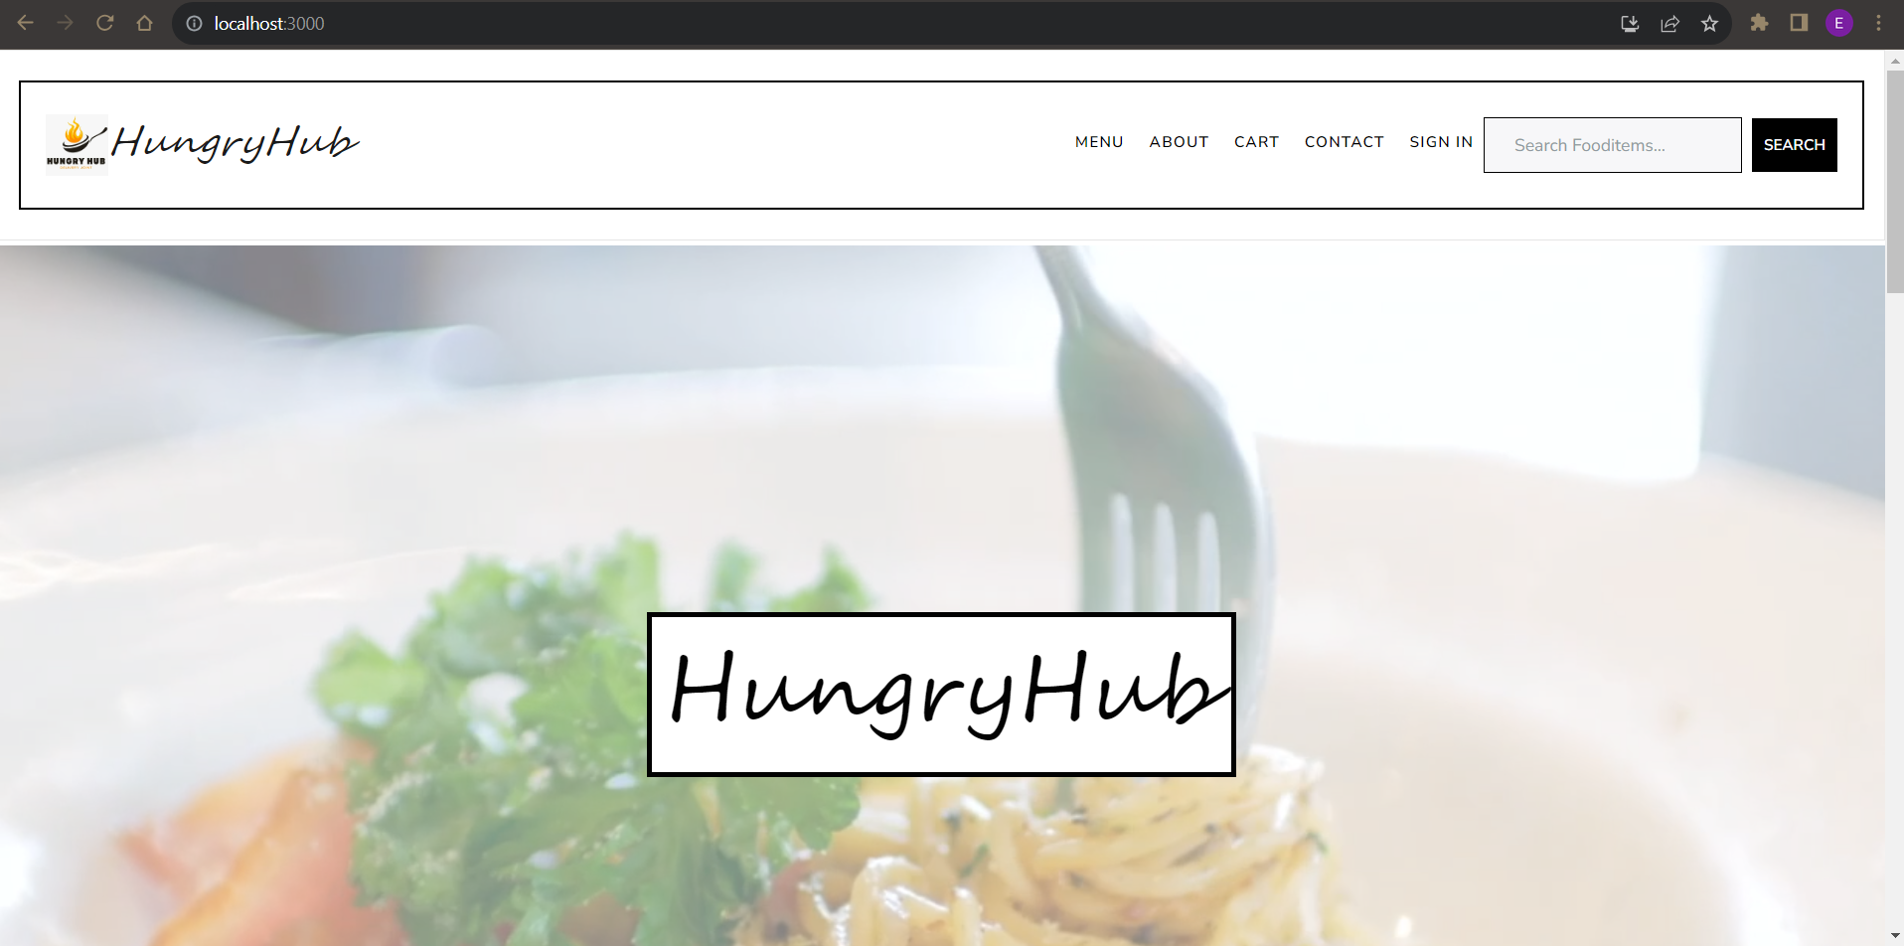

User Interface
Sneak Peek
From an intuitive user interface to robust security measures, get ready for a food delivery experience like never before. Let's take a quick look at what Hungry Hub has in store for you

Slide 9
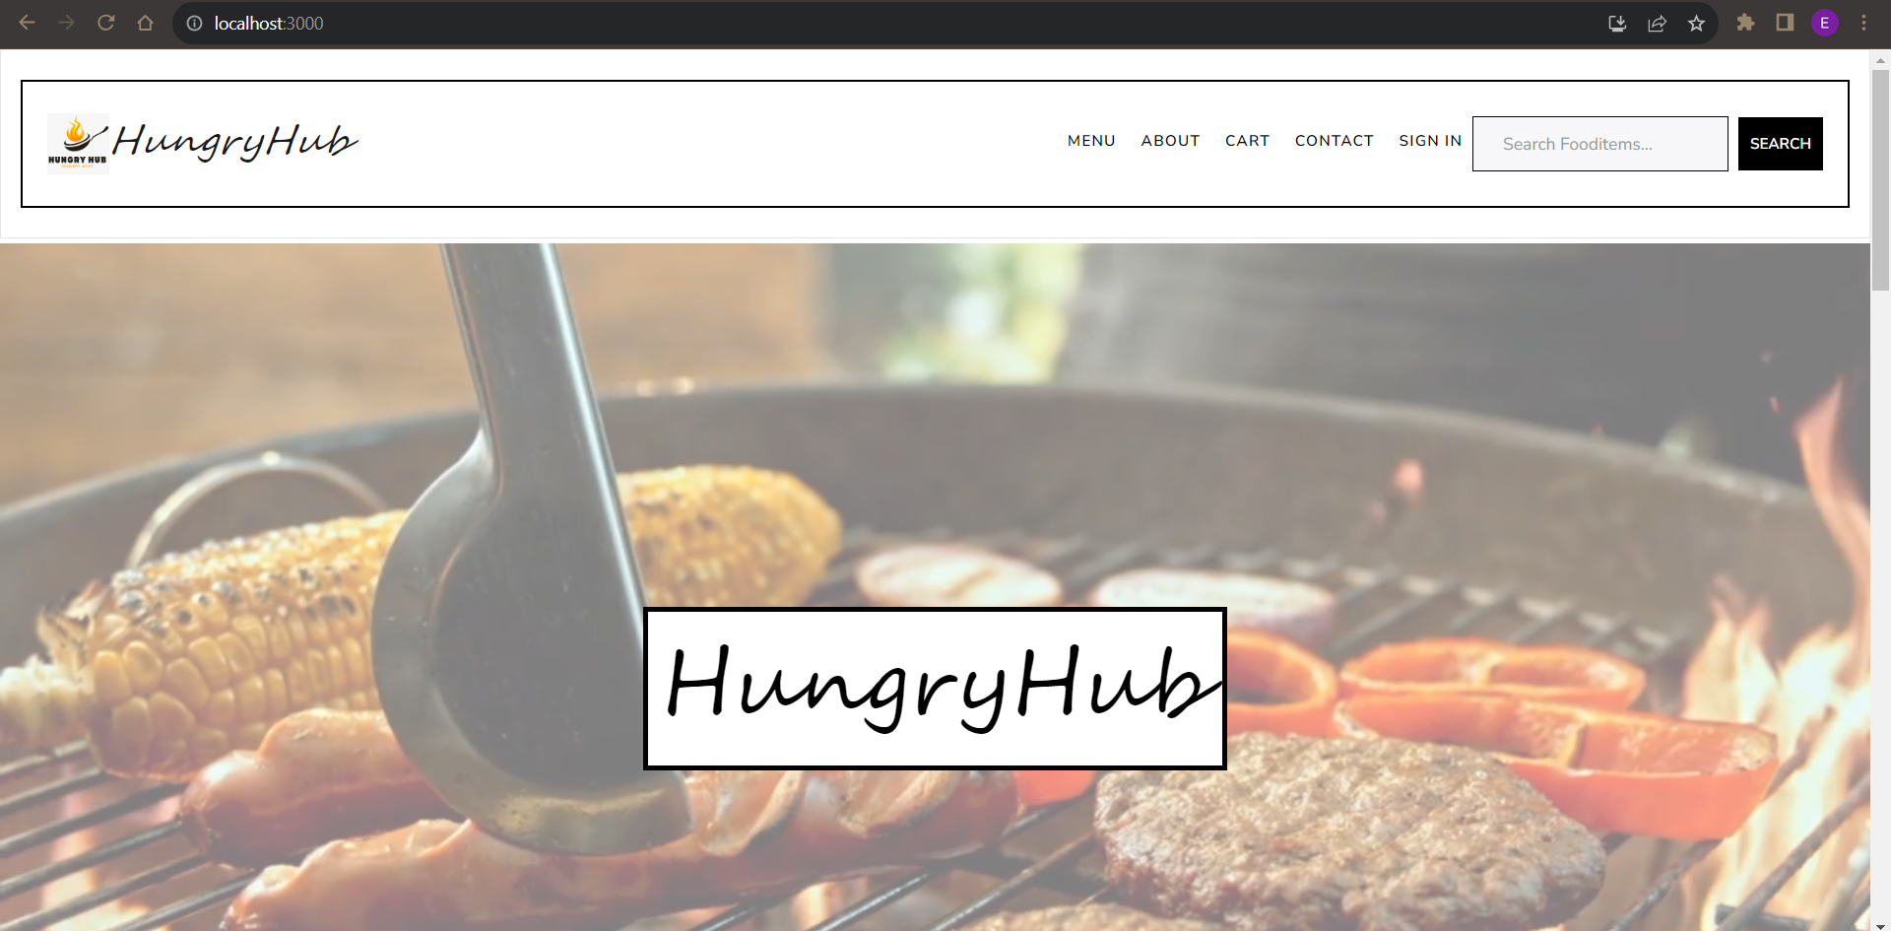

Slide 10
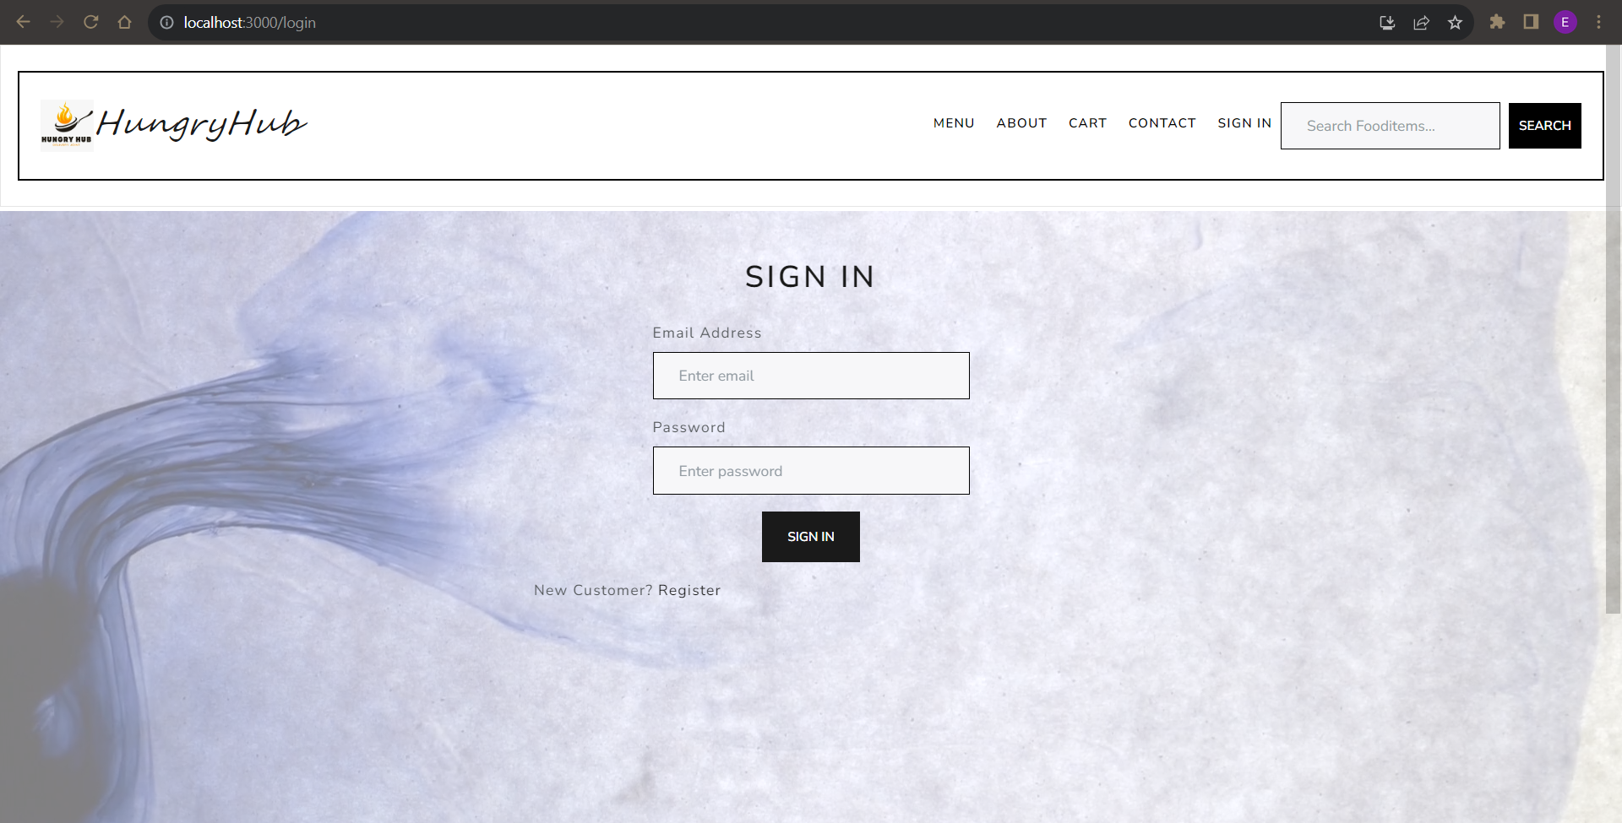

Slide 11
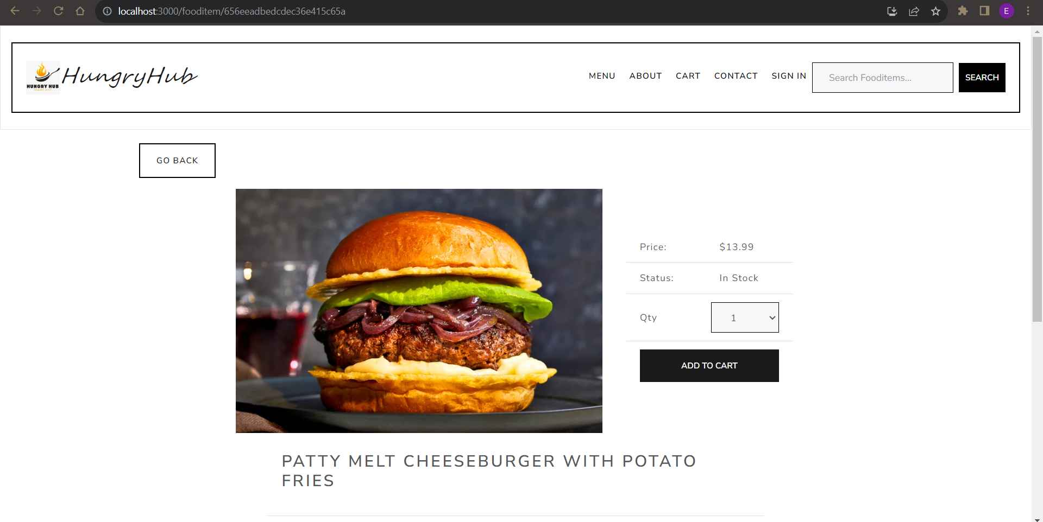

Slide 12
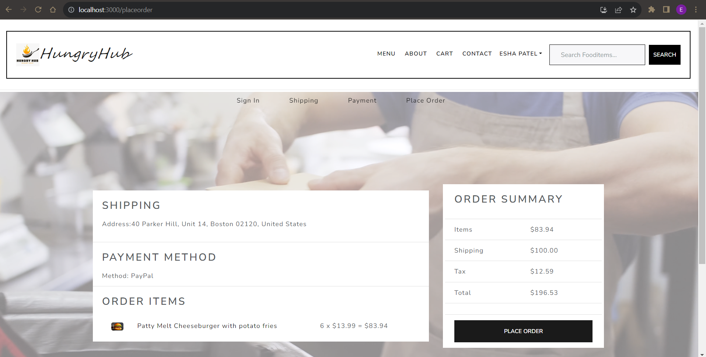

Slide 13
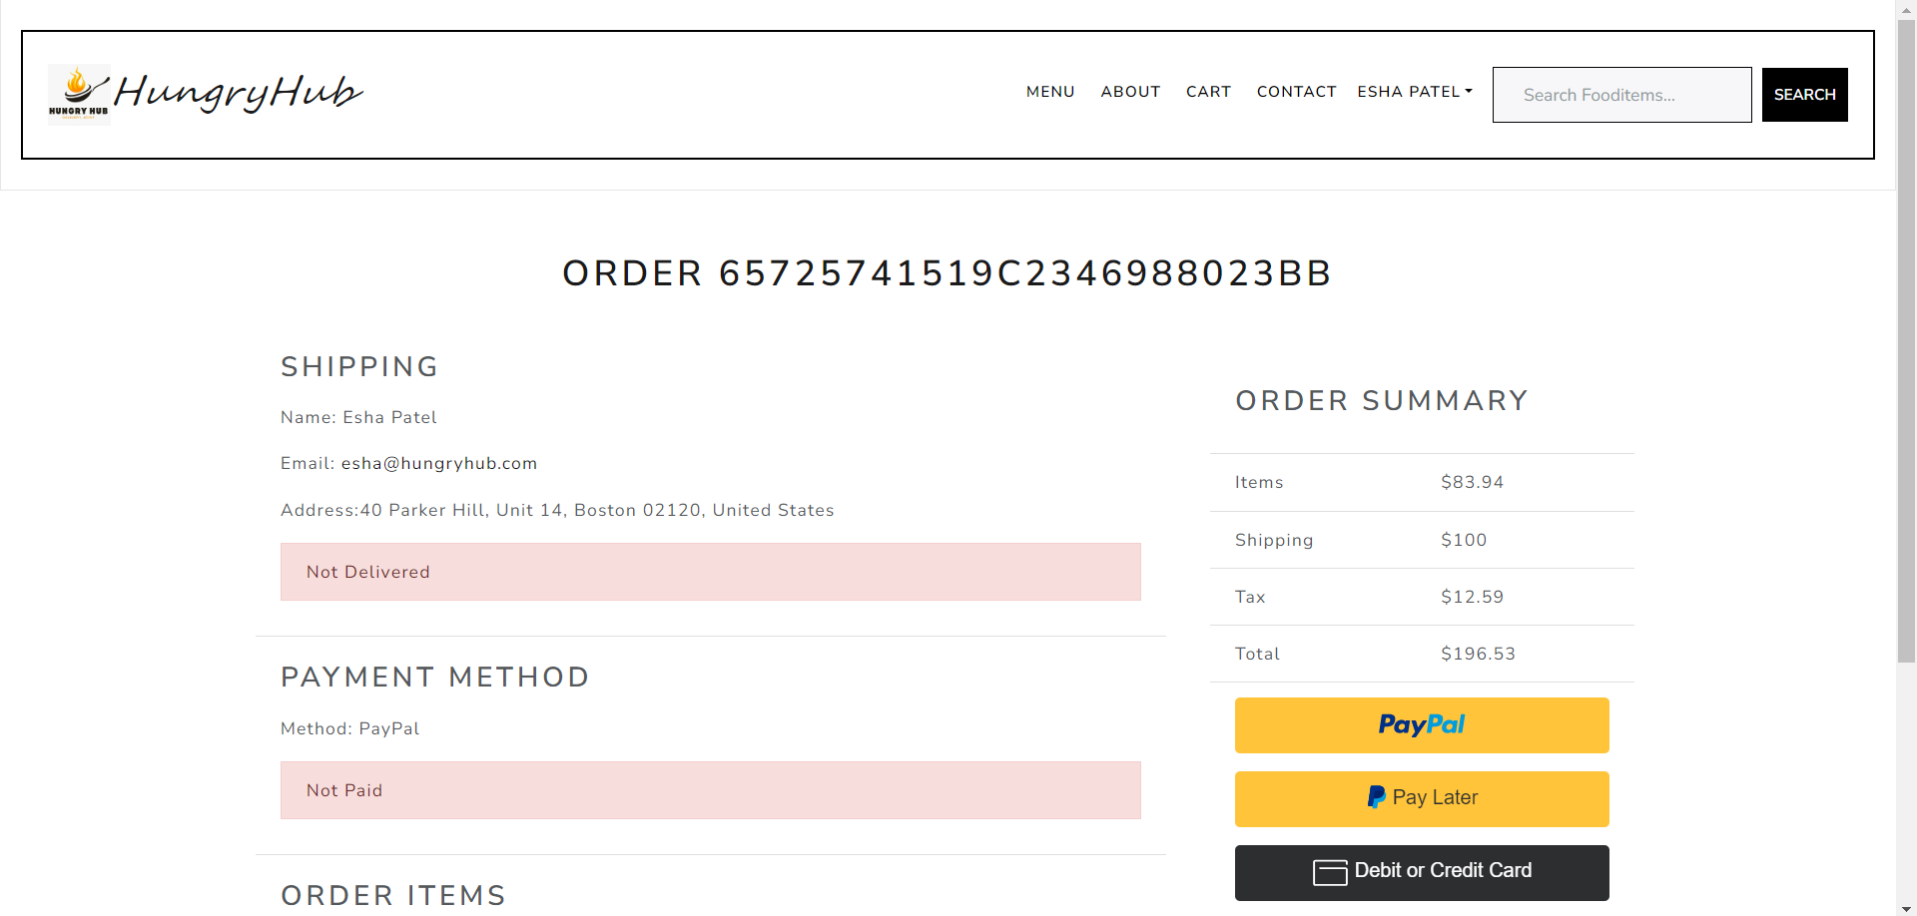

Slide 14
Thank you

